Slide 1
Javascript Concepts
if ( bored() === true ) {
bored().stop();
beEnthusiastic();
}

Slide 2
Scoping
Accessibility

Slide 3
What is scoping?
Accessibility or visibility of variables, functions, and objects.
In simple, the scope of a variable(where it can be accessed) is controlled by the location of the variable declaration.
Importance:
Security.
Namespace collisions

Slide 4
Types of scope -
Global Scope –
Any variable that’s not inside any function or block (a pair of curly braces), is inside the global scope.
Variables can be accessed and modified from anywhere in the program.
Local Scope –
Variables declared inside a function.
Also called as Function scope because local scope is created by functions.
Variables in the local scope are only accessible within that function.

Slide 5
Types of scope -
Block Scope –
Whenever you see {curly brackets}, it is a block. Eg – if, switch, for, while
Scope lies within this block.
const and let keywords allows to declare variables in the block scope.
It differs in case of var keyword.
Example –
function foo () {
if(true) {
var fruit = ‘apple’; //exist in function scope
let vegetable = ‘carrot’; //exist in block scope
const choco = ‘dark choco’; //exist in block scope
}
console.log(fruit); // apple
console.log(vegetable); // vegetable not defined
console.log(choco); // choco not defined
}

Slide 6
Types of scope -
Lexical Scope –
Children scope have the access to the variables defined in the parent scope.
In other words, the inner function scope can access variables from the outer function scope.
Example –
function foo1 () {
var fruit = ‘apple’;
let vegetable = ‘carrot’;
const choco = ‘dark choco’;
function foo2 () {
console.log(fruit, vegetable, choco); //apple, carrot, dark choco
}
foo2 ();
}
foo1 ();

Slide 7
Hoisting
Variables and function declarations are moved to the top of their scope before code execution.

Slide 8
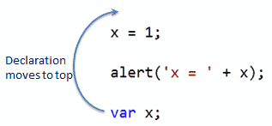
Variable Hoisting
Default behavior of defining all the declarations at the top of the scope before code execution.
Only hoists declarations, not initializations.
Assigns undeclared variable to the global scope
alert ( ‘x = ‘ + x); // x is undefined function hoist () {
var x = 1; a = 10;
var b = 20;
}
hoist();
console.log(a, b) // 10, b is not defined

Slide 9
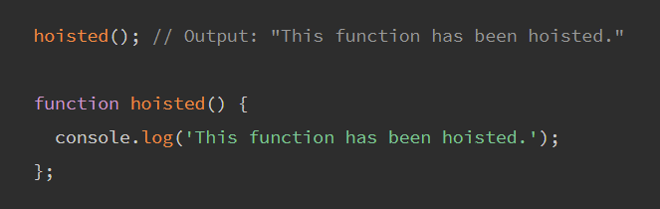
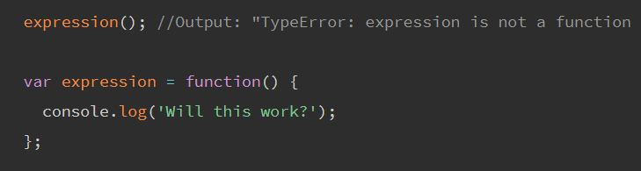
Function Hoisting
Functions are classified as –
Function declarations
Function expressions
Function declaration, can be hoisted.
Function expressions, however are not hoisted.

Slide 10
Currying
Currying is the process of turning a function with multiple arity into a function with less arity — Kristina Brainwave.

Slide 11


Currying
Currying is a technique of evaluating the function with multiple arguments, into a sequence of function with a single argument.
Why it’s useful?
Helps to avoid passing the same variable again and again.
Helps to create a higher order function
So rather than having a function that looks like this:
You end up with something like this:

Slide 12
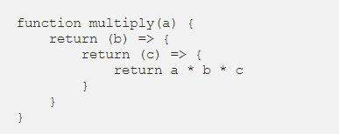




Currying Example
Sample function
Curried Version

Slide 13
Closure

Slide 14
Closure
Closure means that an inner function always has access to the vars and parameters of its outer function, even after the outer function has returned.
The inner function has access to – 1. Its own variables. 2. Outer function's variables and arguments. 3. Global variables.

Slide 15
Closure Example
function counter() {
let count = 0;
return function() {
return count++;
};
};
const countValue = counter();
countValue(); // 0
countValue(); // 1
countValue(); // 2

Slide 16
Any Queries ?

Slide 17
Thank you - Shobika Babu

